Slide 1




AUTOMATED PAPER CUPS SHREDDER SYSTEM

Slide 2
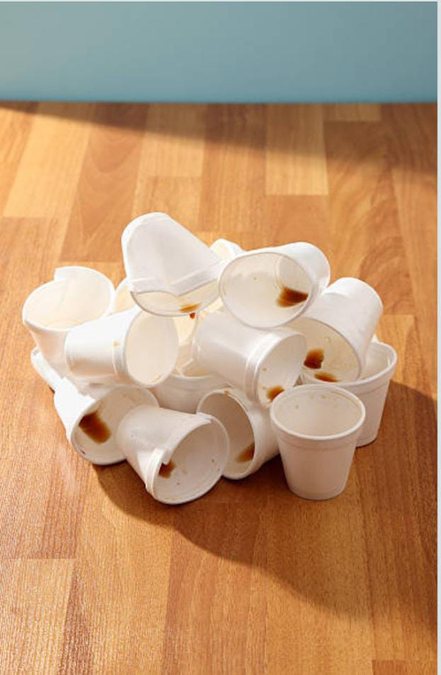
PROBLEM STATEMENT
The widespread use of paper cups in restaurants, offices, and public events has led to a significant increase in solid waste. Although paper cups are often marketed as eco-friendly, many are lined with plastic coatings, making them difficult to recycle through conventional methods. As a result, they contribute heavily to landfill accumulation and environmental pollution.
Manual disposal and shredding of cups is inefficient, labor-intensive, and unsafe. Current waste management systems lack a dedicated mechanism to handle paper cups specifically, leading to:
High volume of waste due to their bulky shape.
Increased transportation costs for disposal.
Reduced recycling efficiency because unprocessed cups cannot be easily separated into usable materials.
Therefore, there is a pressing need for an automated shredder system that can efficiently process paper cups by reducing their size, separating recyclable components, and minimizing environmental impact. Such a system would improve waste management, reduce landfill pressure, and support sustainable recycling practices.

Slide 3
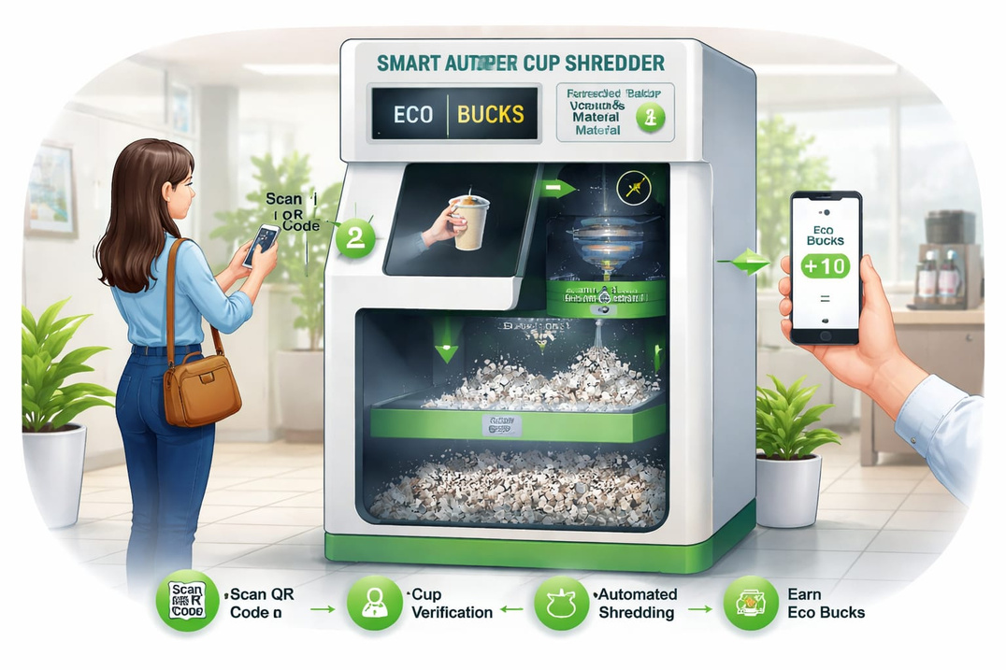
SOLUTION PROPOSED
The proposed system is a Smart Automated Paper Cup Shredder with Eco Bucks Reward System designed to encourage proper disposal of paper cups.
Users scan a QR code using the mobile app before depositing a used paper cup into the machine. A camera detects and verifies the cup, and Eco Bucks reward points , that are automatically credited to the user’s app account.
The deposited cups are automatically directed to the shredder mechanism for size reduction. The shredded material is then transferred to a lower chamber for drying and safe storage.
This system reduces manual effort, ensures organized waste handling, and motivates public participation through a reward-based collection model.

Slide 4
NOVELTY AND UNIQUENESS
Integrated Eco Bucks reward system to motivate proper disposal.
QR-based user authentication to prevent misuse.
Camera-based cup verification for accurate detection.
Automated shredding mechanism for volume reduction.
Designed specifically to handle plastic-lined paper cups.
Reduces transportation cost and landfill burden.
Promotes sustainable and organized waste management.

Slide 5
COMPETITIVE ANALYSIS
Existing waste management systems such as traditional dustbins only collect paper cup waste without any processing or segregation. They do not reduce the volume of waste, nor do they encourage user participation. As a result, large quantities of bulky paper cups are sent directly to landfills.
Manual shredding methods require human effort, are time-consuming, and may pose safety risks. They also lack consistency and do not provide any motivation for proper disposal.
In comparison, the proposed Smart Automated Paper Cup Shredder offers a fully automated solution with QR-based user authentication and camera verification. It not only reduces the volume of waste through shredding but also introduces an Eco Bucks reward system to encourage responsible disposal. This makes the system more efficient, safe, sustainable, and user-engaging compared to existing solutions

Slide 6
SOCIAL IMPACT
The proposed Smart Automated Paper Cup Shredder creates a positive social impact by promoting responsible waste disposal habits among the public. By introducing the Eco Bucks reward system, it encourages people to actively participate in environmental protection.
The system reduces littering in public places such as restaurants, offices, and events, helping to maintain cleaner surroundings. It also spreads awareness about the importance of recycling plastic-lined paper cups, which are often neglected in traditional waste management systems.
Additionally, the project supports sustainable practices, reduces landfill burden, and contributes to a greener and healthier community. By combining technology with environmental responsibility, the system fosters long-term behavioral change in society.

Slide 7
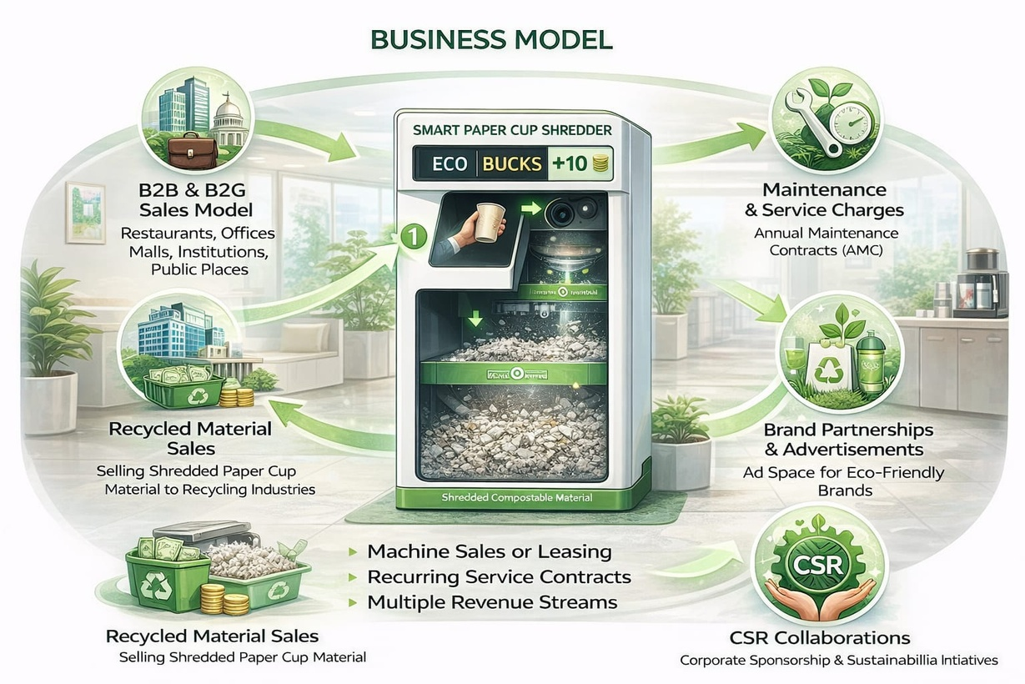
BUSINESS MODEL
The proposed Smart Automated Paper Cup Shredder operates on a B2B (Business-to-Business) and B2G (Business-to-Government) model. The machine can be installed in restaurants, corporate offices, shopping malls, educational institutions, and public places.
Revenue will be generated through:
Machine Sales or Leasing Model – Organizations can purchase the machine or take it on a monthly rental basis.
Maintenance and Service Charges – Annual maintenance contracts (AMC) for regular servicing.
Recycled Material Sales – Shredded paper cup material can be sold to recycling industries.
Brand Partnerships & Advertisements – Display space on the machine or mobile app for eco-friendly brands.
CSR Collaborations – Companies can sponsor installations as part of their Corporate Social Responsibility initiatives.
The Eco Bucks reward system increases user engagement, ensuring continuous usage, which strengthens the sustainability of the business model.

Slide 8
MARKET OPPORTUNITIES
The increasing use of disposable paper cups in restaurants, cafes, corporate offices, colleges, hospitals, and public events creates a large and growing market demand for an efficient waste management solution.
Governments and municipalities are actively promoting sustainable waste management practices, creating opportunities for collaboration and large-scale implementation in smart cities.
The rising awareness about environmental pollution and plastic-lined paper cup waste opens opportunities for eco-friendly innovations like this automated shredder system.
Potential market segments include:
Restaurants and coffee shops
IT parks and corporate offices
Educational institutions
Shopping malls and airports
Event management companies
Municipal corporations

Slide 9
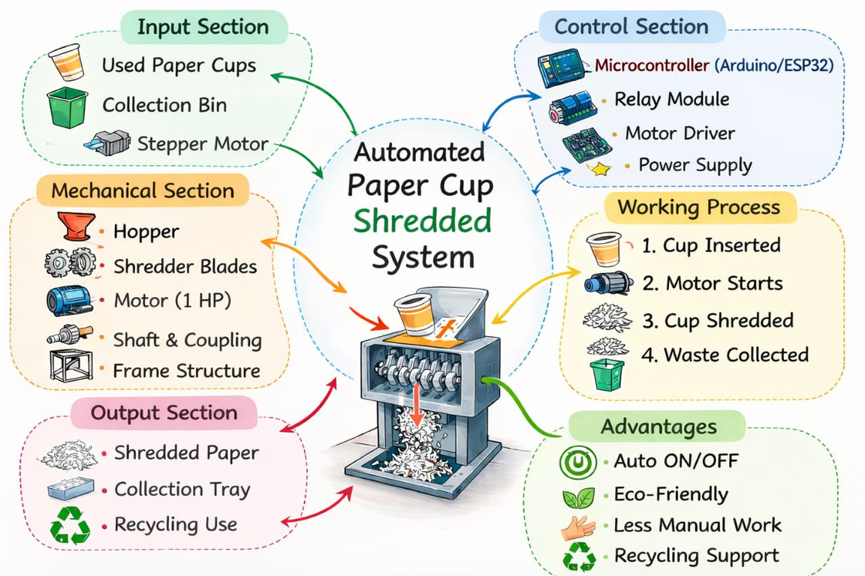
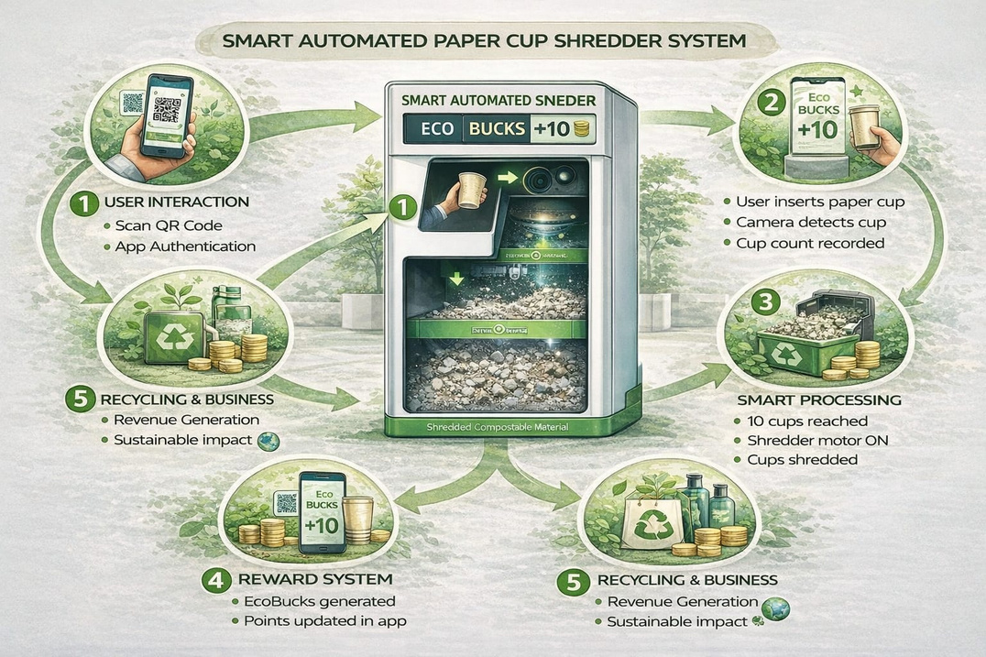
RELATED IMAGES

Slide 10
THANK YOU

